Slide 1
Tree Data Structure

Slide 2
Introduction
A tree data structure is defined as a collection of objects or entities known as nodes that are linked together to represent or simulate hierarchy.
A tree data structure is a non-linear data structure because it does not store in a sequential manner. It is a hierarchical structure as elements in a Tree are arranged in multiple levels.
In the Tree data structure, the topmost node is known as a root node. Each node contains some data, and data can be of any type.
Each node contains some data and the link or reference of other nodes that can be called children.

Slide 3
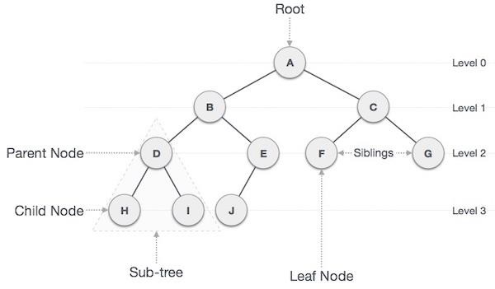
Basic terminologies
Root − The node at the top of the tree is called root. There is only one root per tree and one path from the root node to any node.
Parent − Any node except the root node has one edge upward to a node called parent.
Child − The node below a given node connected by its edge downward is called its child node.
Leaf − The node which does not have any child node is called the leaf node.
Subtree − Subtree represents the descendants of a node.
Visiting − Visiting refers to checking the value of a node when control is on the node.
Traversing − Traversing means passing through nodes in a specific order.
Levels − Level of a node represents the generation of a node. If the root node is at level 0, then its next child node is at level 1, its grandchild is at level 2, and so on.
Keys − Key represents a value of a node based on which a search operation is to be carried out for a node.
Edge: A connection between two nodes. It defines the relationship between parent and child nodes.
Path − Path refers to the sequence of nodes along the edges of a tree.
Height of a node- The number of edges on the longest path from that node to a leaf.
Height of a tree- The height of the root node.
Depth of a node-The number of edges from the root to that node.
Degree of a node- The number of children a node has

Slide 4
Types of Trees
General Trees
Binary Trees
Binary Search Trees

Slide 5
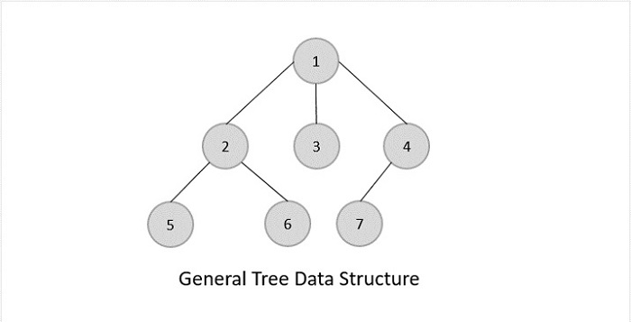
General Trees
General trees are unordered tree data structures where the root node has minimum 0 or maximum ‘n’ subtrees.
The General trees have no constraint placed on their hierarchy. The root node thus acts like the superset of all the other subtrees.

Slide 6
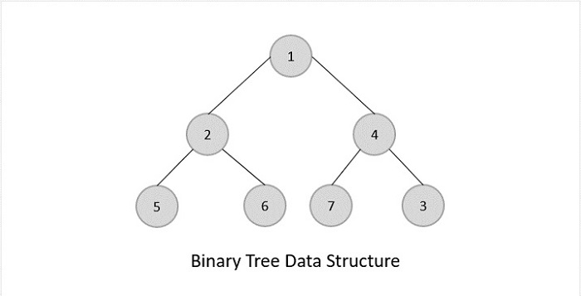
Binary Trees
Binary Trees are general trees in which the root node can only hold up to maximum 2 subtrees: left subtree and right subtree.
Based on the number of children, binary trees are divided into three types:
Full Binary Tree
A full binary tree is a binary tree type where every node has either 0 or 2 child nodes.
Complete Binary Tree
A complete binary tree is a binary tree type where all the leaf nodes must be on the same level.
Root and internal nodes in a complete binary tree can either have 0, 1 or 2 child nodes.
Perfect Binary Tree
A perfect binary tree is a binary tree type where all the leaf nodes are on the same level and every node except leaf nodes have 2 children.

Slide 7
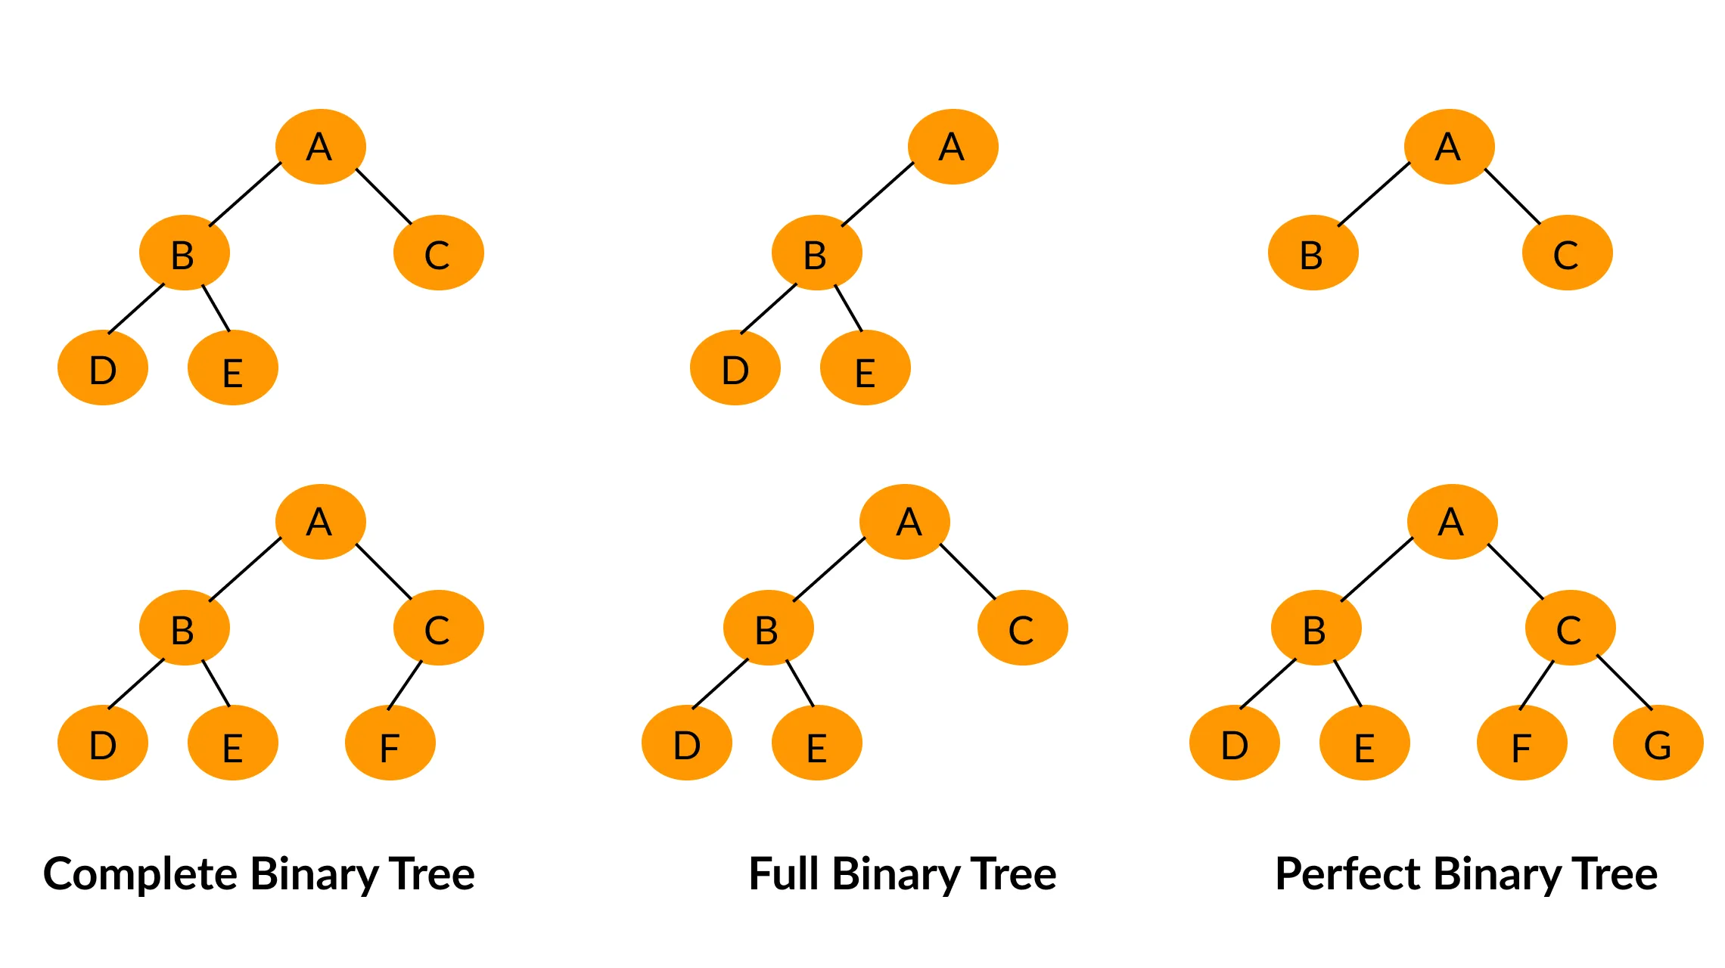

Slide 8
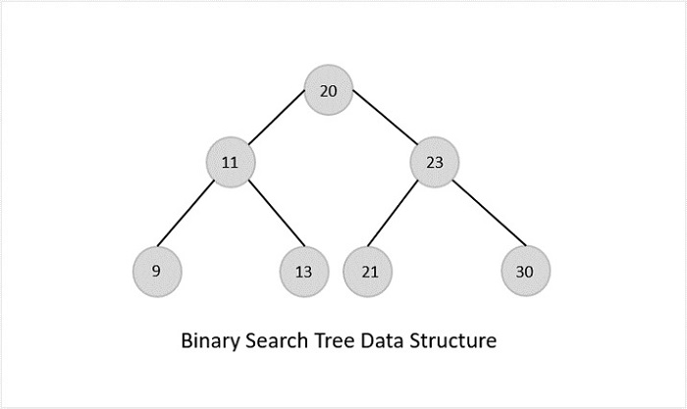
Binary Search Trees
Binary Search Trees possess all the properties of Binary Trees including some extra properties of their own, based on some constraints, making them more efficient than binary trees.
The data in the Binary Search Trees (BST) is always stored in such a way that the values in the left subtree are always less than the values in the root node and the values in the right subtree are always greater than the values in the root node, i.e. left subtree < root node ≤ right subtree.

Slide 9
Advantages of BST
Binary Search Trees are more efficient than Binary Trees since time complexity for performing various operations reduces.
Since the order of keys is based on just the parent node, searching operation becomes simpler.
The alignment of BST also favors Range Queries, which are executed to find values existing between two keys. This helps in the Database Management System.

Slide 10
Disadvantages of BST
This skewness will make the tree a linked list rather than a BST, since the worst case time complexity for searching operation becomes O(n).

Slide 11
Tree Operations
Insertion: Adding a node to the tree while maintaining its properties.
Deletion: Removing a node from the tree while maintaining the tree’s properties.
Traversal: Visiting all nodes in a particular order:
In-order (left, root, right): Often used in binary search trees to retrieve elements in sorted order.
Pre-order (root, left, right): Useful for copying trees.
Level-order (breadth-first): Visiting nodes level by level from the root.
Post-order (left, right, root): Useful for deleting trees.

Slide 12
Applications of Trees
File systems: Hierarchical storage of files and directories.
Databases: B-trees and variants are used for indexing.
Networking: Routing algorithms use tree structures.
Expression evaluation: Expression trees are used to evaluate algebraic expressions.

Slide 13
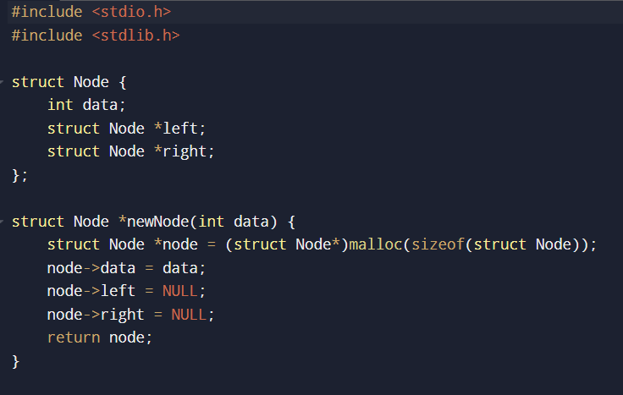
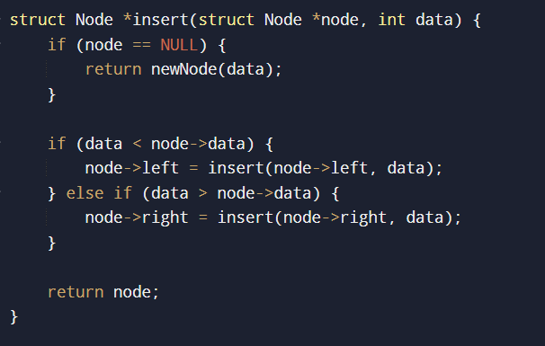
Binary Search Tree Implementation

Slide 14
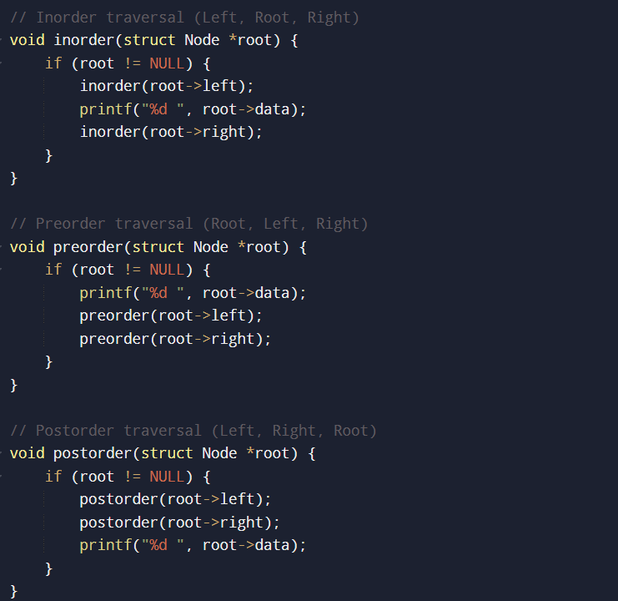
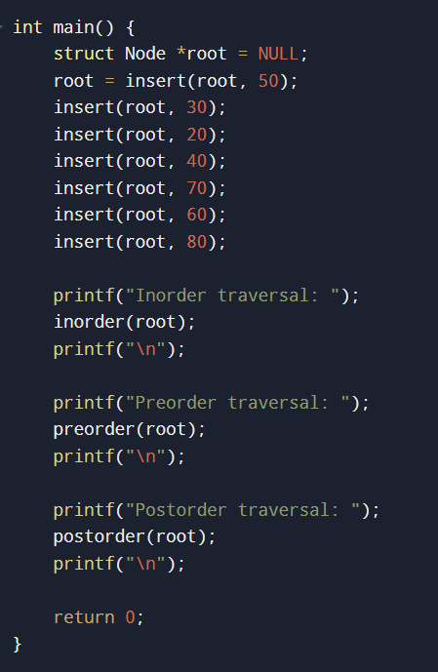

Slide 15
Deleting a node in a Binary Search Tree (BST)
The process depends on the node you want to delete and how many children it has.
Here are the three main cases to consider when deleting a node in a BST:
Node has no children (Leaf node):
Simply remove the node.
Node has one child:
Remove the node and replace it with its child.
Node has two children:
Find the node’s inorder predecessor/ inorder successor, copy its value to the node being deleted, and then delete the predecessor or successor.

Slide 16
